Slide 1


Intro to Incidence Response
UIC Cyber Sig

Slide 2
What is IR?
IR is the “handling” of cyber security events
Events such as…
-Unauthorized use of privileges
-Access and Exfiltration of sensitive data
-Malware entering your systems
Analysts may use tools such as siems, edrs, ids, ips…. to find events

Slide 3

The Basics
Cyber Kill Chain, and Mitre Frameworks

Slide 4

APTS
Advanced Persistence Threats
Organized groups of hackers with resources
Examples Include…
The Equation Group – NSA
The Lazarus Group – Dropped WannaCry

Slide 5
The Cyber Kill Chain
A framework for cyberdefense
Explains how APTS progress through an attack
Consists of 7 stages
Each stage represents a different goal
Each stage must be accomplished to move on to the next one
*Some say this is outdated, but I still see it in job postings all the time*

Slide 6
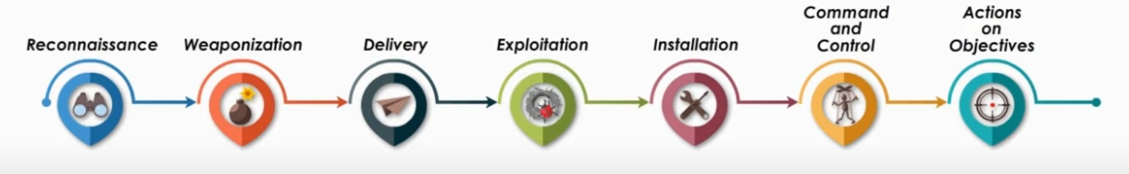
The Cyber Kill Chain

Slide 7
Break the Chain
Breaking the chain at any stage stops the attack

Slide 8
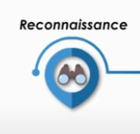
Reconnaissance
Goal: Attackers are attempting to find good targets and information about your organization
Examples include…
Harvesting info on employees
-Emails, Facebook, Phone numbers, etc
Details about your webserver
-Frameworks, Locations, Services
Really anything that they can leverage against you…

Slide 9
Reconnaissance - Mitigations
Mitigations are often cheap but take a lot of time…
Limit sensitive information broadcast to the internet
Use Firewalls, Siems, etc to stop attackers from scanning networks
Train employees not to give out information on the company on social media
Basically, find all the information about your organization -
-available online, and remove anything sensitive

Slide 10
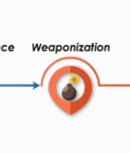
Weaponization
Goal: Attacker’s craft a tool for vulnerable target
Examples such as…
A custom packet for a vulnerable service
Ransomware
Combining exploit with backdoor into a payload

Slide 11
Weaponization-Mitigations
Stopping Reconnaissance
Increasing security posture to decrease attack surface prior
Patching software
That’s really it…
Once an attacker has information on your network, there’s nothing you can do to stop them from creating exploits…

Slide 12

Delivery
Goal: Delivering payload to the target
Methods:
USB
Email
Network Packets
Anything else they can think of

Slide 13
Delivery – Mitigations
Firewalls, ACL’s to block malware, risky websites, and attacker communications
Antivirus/ AntiMalware on all Endpoints and Network
Limit download and install user privileges
Training on USB’s or just disabling USB ports altogether

Slide 14
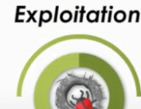
Exploitation
Goal: Basically, Code Execution…
Powershell scripts (Uber/R* Hack)
Local Job Scheduled

Slide 15
Exploitation – Mitigations
Keeping systems and devices patched/updated
Having mechanisms in place to spot and report malware infections
-Training employees
-Using EDR / NDR software
At this point, things aren’t looking too good…

Slide 16

Installation
Goal: Attacker installs a backdoor/malware
Some examples are….
Trojans
New user accounts (with admin privs)
Escalating old user accounts
Scripts that allow an attacker to launch a reverse connection
Registry Entries (Sticky Keys backdoor)

Slide 17
Installation - Mitigations
Its not too late just yet! Breaking the chain at ANY stage stops the attack
You can do the following to mitigate this stage…
Limiting user account privileges (executing, installing software)
Preventing and logging when a new account is created
Implementing strong passwords and 2FA

Slide 18

C & C
Goal: Attacker attempts to covertly contact exploited machine for further actions
Examples:
Hollowed Process contacts mothership
Hidden User contacts the C&C endpoint

Slide 19
Installation - Mitigations
Monitoring and blocking sus outbound traffic
URL Filtering
HoneyPots and HoneyNets

Slide 20

MITRE ATTACK

Slide 21
ATT&CK
Used as a common language to explain cyber security events
information on APT’s, Techniques, Mitigations, etc

Slide 22
ATT&CK common use cases
Detections and Analytics
Threat Intelligence
Adversary Emulation and Redteaming
Assessment and Engineering
*All of these are very similar*

Slide 23

Detection and Analytics

Slide 24
Detections and Analytics
Understand what data and search capabilities you have
One way to do this is to look at the Data Sources listed for each ATT&CK technique.
Common Sources used for many detections…
Process and process command line monitoring
File and registry monitoring (Sysmon, Windows Event Logs)
Authentication Logs (D.C. Logs, events)
Packet Capture

Slide 25
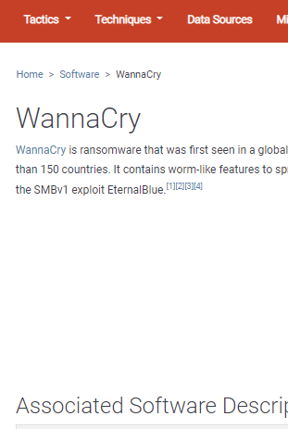
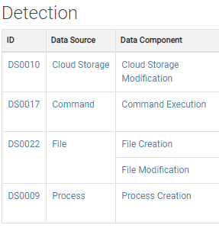
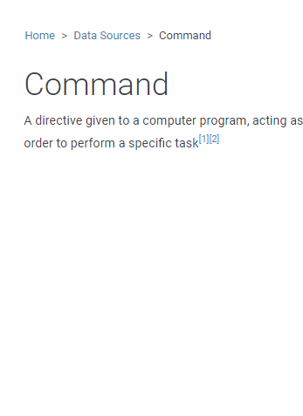
Data Sources Example
Click 1
Click 2
Click 3
*DS stands for data source*

Slide 26

Detections and Analytics
Collect data into a SIEM to run analytics against it
Create custom analytics or use a repo!
https://car.mitre.org/analytics/ - MITRE Cyber Analytics

Slide 27
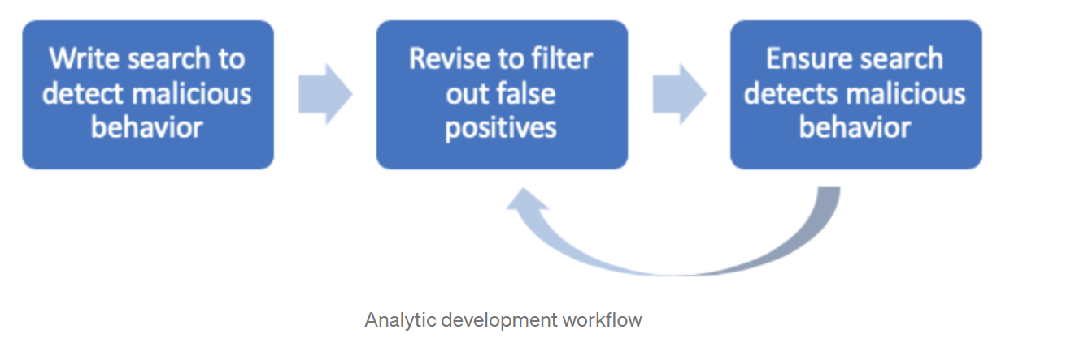
Detections and Analytics
Using analytics is a tuning process…
Too many alerts is just as bad as no alerts!
This was a focus at BlueCon

Slide 28

Threat Intelligence

Slide 29

Threat Intelligence
Know what the enemy is doing
-Use that information to make plans
Pick a group, start countering their plays

Slide 30
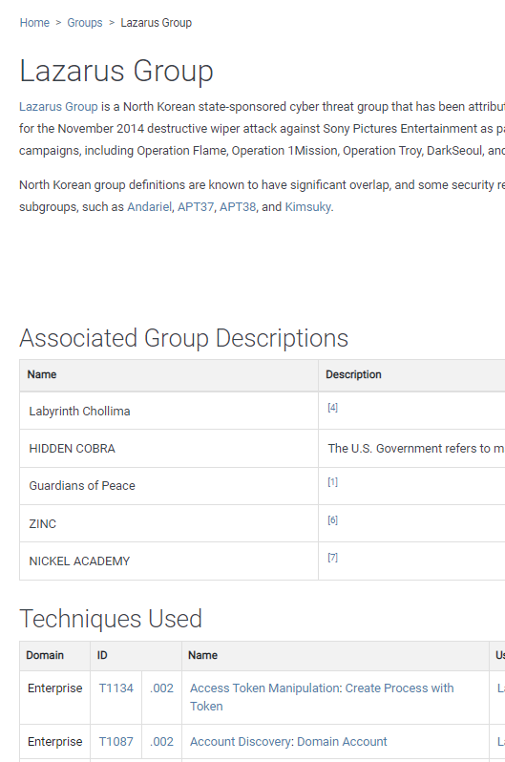
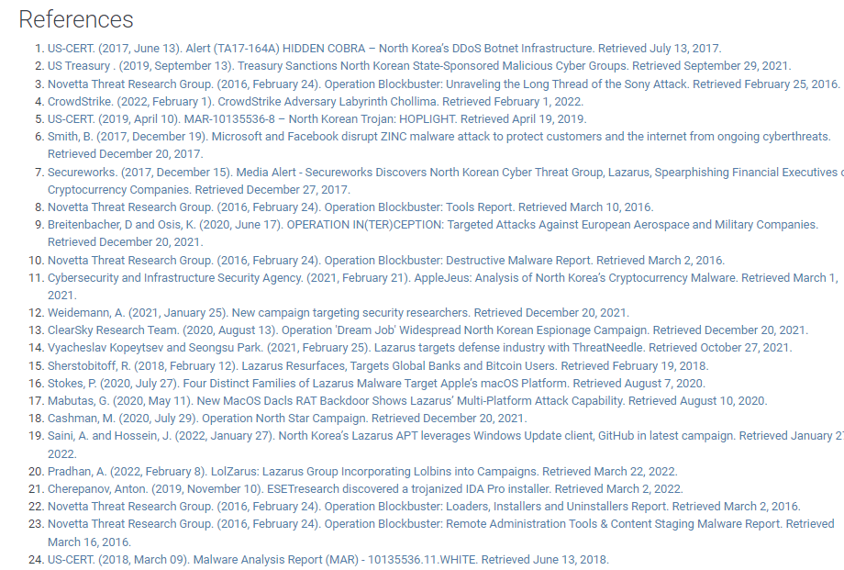
Threat Intelligence

Slide 31

The other stuff
Adversary Emulation and Redteaming
Assessment and Engineering
These are basically the same as threat intelligence, just the perspective is changed (RedTeam, BlueTeam, etc)
Focus on techniques, and coverage instead of APT’s

Slide 32
Demo? If I have time
Create a simple analytic for Windows RDP
https://attack.mitre.org/techniques/T1021/001/

Slide 33
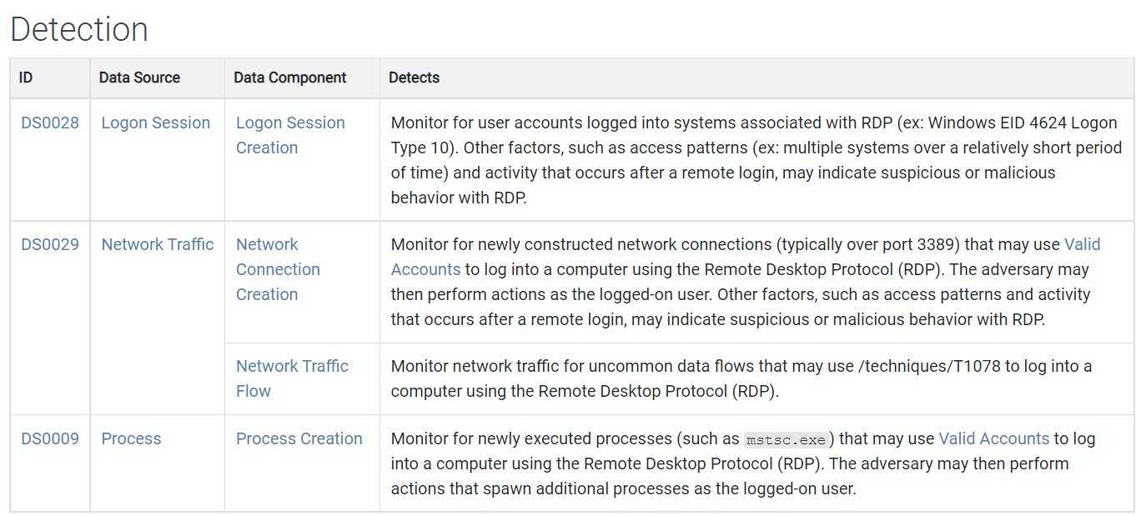
Check MITRE for Data Sources

Slide 34
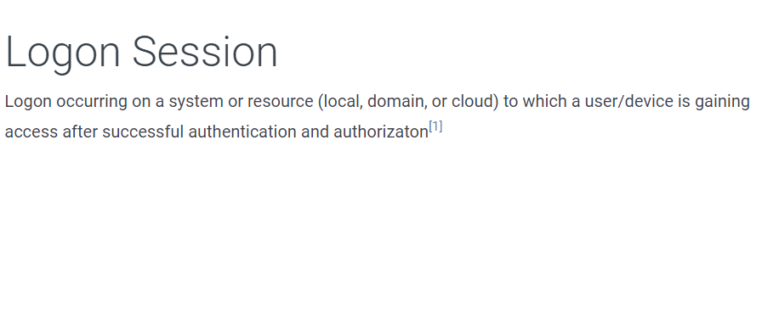
Check references

Slide 35
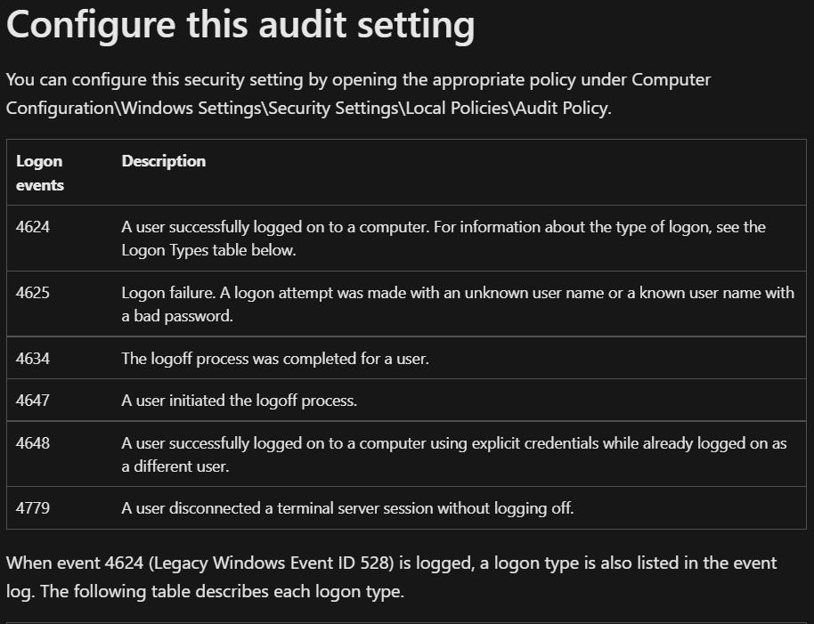
Logins aren’t tracked by default

Slide 36
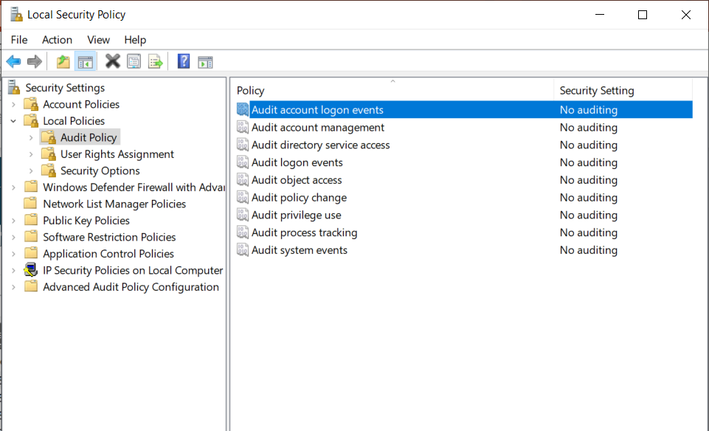
Enable Auditing

Slide 37
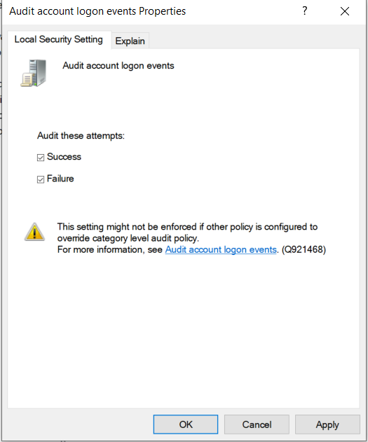
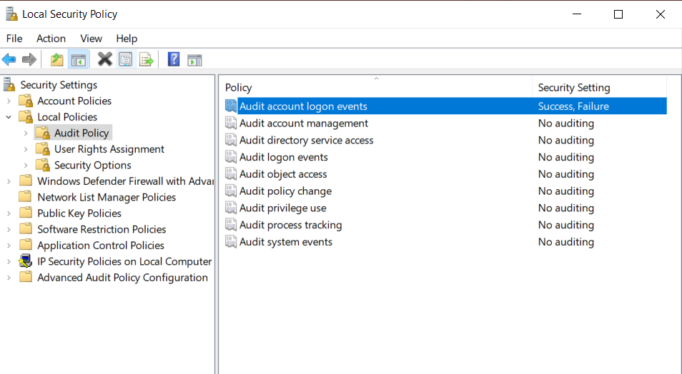
Enable Auditing

Slide 38
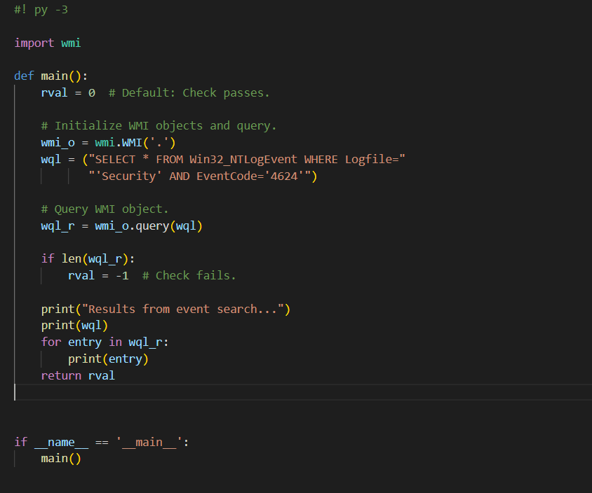
Python
I searched online for Python code to grab events from event viewer. I edited it to log windows login events
https://stackoverflow.com/questions/11219213/read-specific-windows-event-log-event

Slide 39
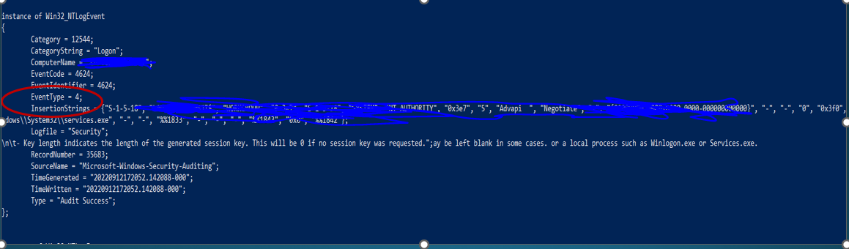
Python
This is working well, but its returning ALL login events, nots just RDP

Slide 40
Python
As you can see there are not entries for RDP

Slide 41
Notes
Depending on your topology you may have to edit GPOs to audit events
In an actual environment, RDP logs would be stored in the Application Log, not Security. I did this demo on a personal home computer that isn’t part of any policies, and messing around with the group policies was taking too much time.

Slide 42
More Notes
Obviously a SIEM will have its own way of adding analytics, I just chose python because I am working on a project to create a lightweight IDS

Slide 43
References
Cyber Kill Chain
https://www.lockheedmartin.com/en-us/capabilities/cyber/cyber-kill-chain.html
https://www.youtube.com/watch?v=LqCbpiDyN8o
https://www.dropbox.com/s/pc4tzk1hgqlhu1e/Chapter%201%20-%20Kill%20Chain.docx?dl=0
MITRE ATT&CK
https://attack.mitre.org/ - Main Mitre webpage
https://medium.com/mitre-attack/getting-started-with-attack-detection-a8e49e4960d0 – Blog explaining how to use MITRE Framework
https://car.mitre.org/analytics/ - Analytic Repositories

Slide 44
References
https://stackoverflow.com/questions/11219213/read-specific-windows-event-log-event - Python Windows Event Scripting
https://www.ultimatewindowssecurity.com/securitylog/encyclopedia/event.aspx?eventID=4624 – Windows Event 4624 Info

